Slide 1

MAHATMA GANDHI MISSION
DR. G. Y. PATHRIKAR COLLEGE OF COMPUTER SCIENCE AND INFORMATION TECHNOLOGY
Presentation on
MEDICAL BILLING MANAGEMENT SYSTEM
Guided by :
Dr. Yogesh Rajput Sir
Submitted by :
Suraj Chaudhary
Nikhil Borse
Komal Chavan
Kamraj Babu
B.Sc. (Computer Science) Sixth Semester
Academic Year 2019-2020

Slide 2
OBJECTIVES-:
Medical Billing Management System is designed to focus on the medical store to help them in their billing management with taking care of other details like stock and accounting. As today in the country most of the medical stores are manual only which means they maintain their record of the person buying drugs and quantity of it in the paper files, registers and blinders.
This system automatically update the record in all database as cutomers buys the medicines which saves the store’s time and the resources.

Slide 3
Hardware and Software Requirements
HTML(Hypertext Mark up Language)
HTML describes the structure of a web page
HTML elements tell the browser how to display the content.
CSS (Cascading Style Sheet)
CSS describes how HTML elements are to be displayed on screen, paper or other media.
External style sheets are stored in CSS file.
3. PHP (Hypertext Pre Processor)-:
PHP can generate dynamic page content
PHP can create, open, write, delete and close files on the server
4. Software Tools Used-:
Sublime Text Editor-: Free, open Source text editor for coding
Xampp Server
Various Browsers (For Testing Website)

Slide 4
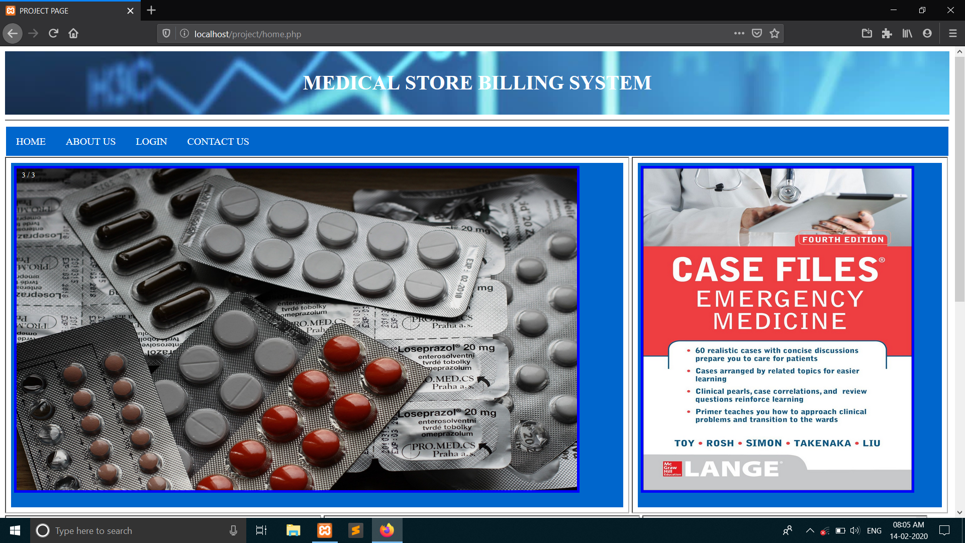
USER INTERFACE DESIGN
Home page-:

Slide 5
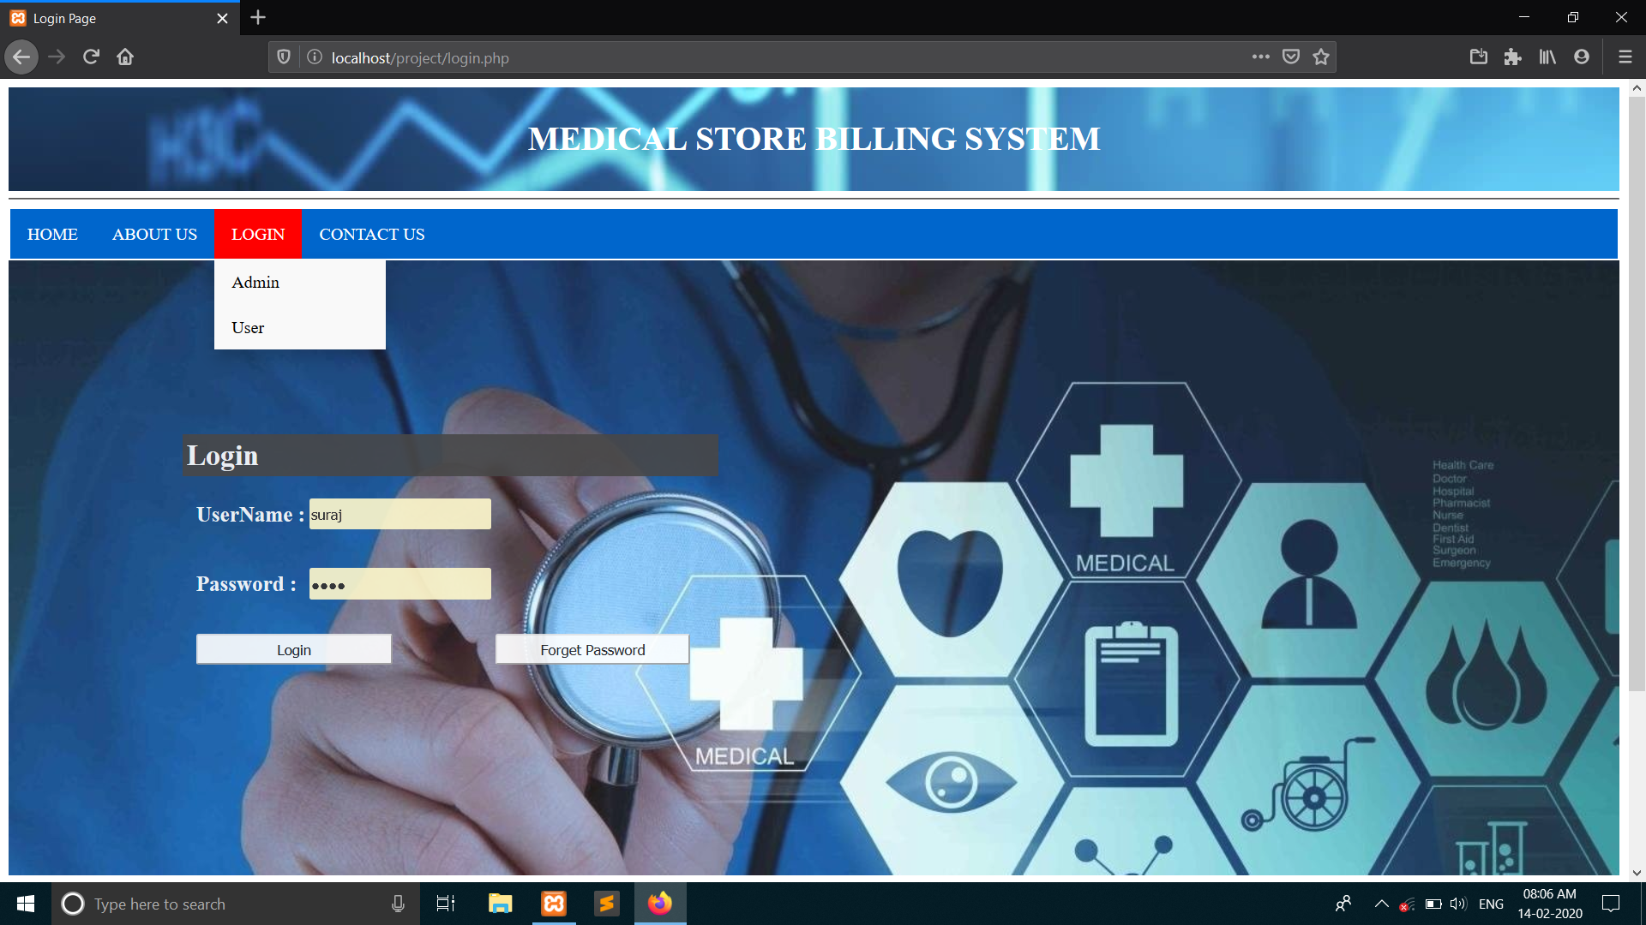
Login page
In these page there are two types of logins , Admin and user.
If any have problem with login they can contact us by clicking Contact us tab.

Slide 6
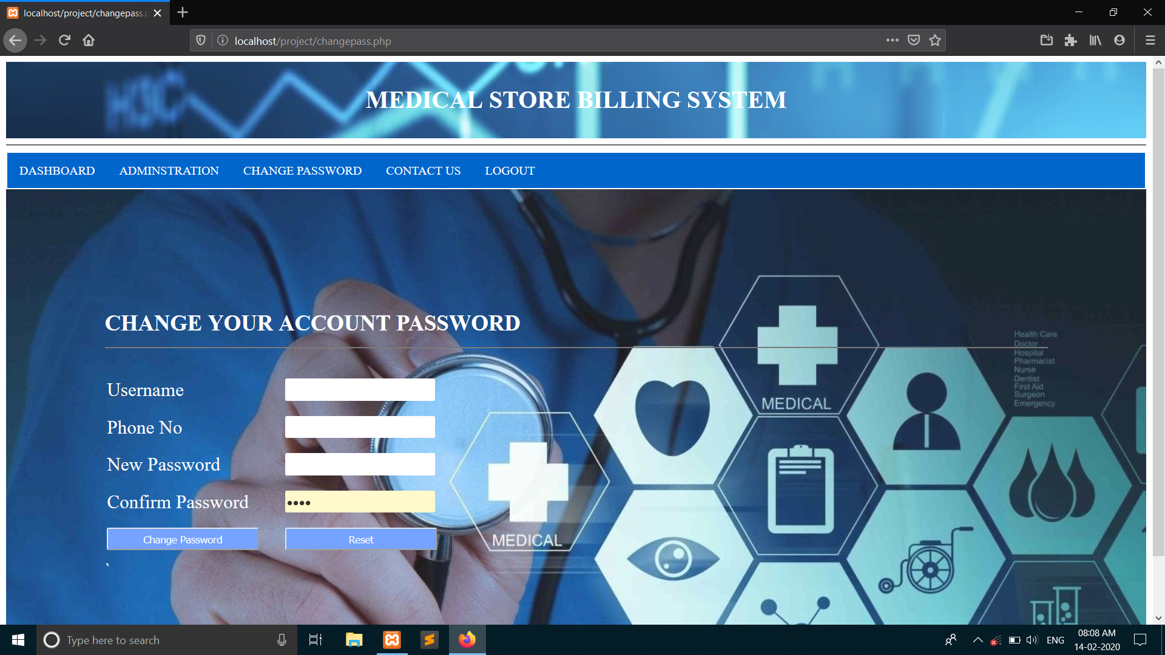
Create new user(admin)
In these Admin creates New user for the access of other web pages in same web application.
Once new user creates, he can access other options and web pages.

Slide 7
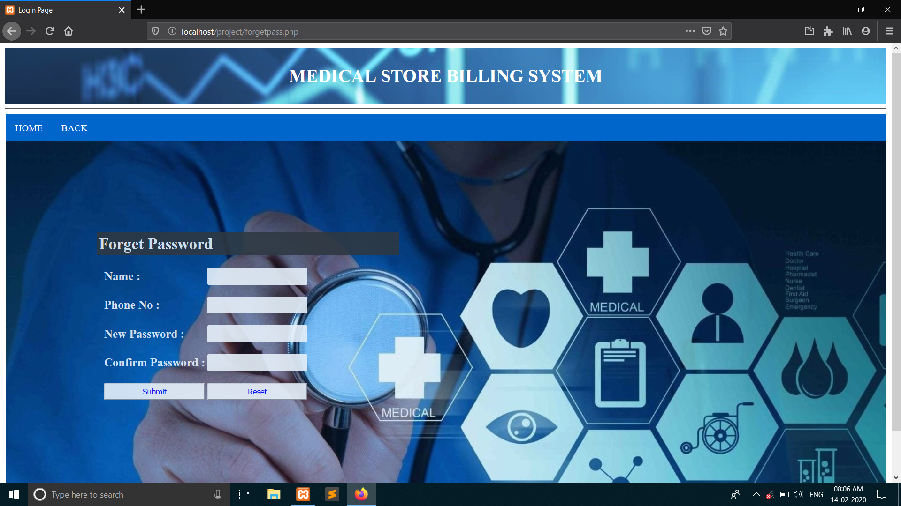
FORGET PASSWORD
If user forget his password then they recover by forget password tab.

Slide 8
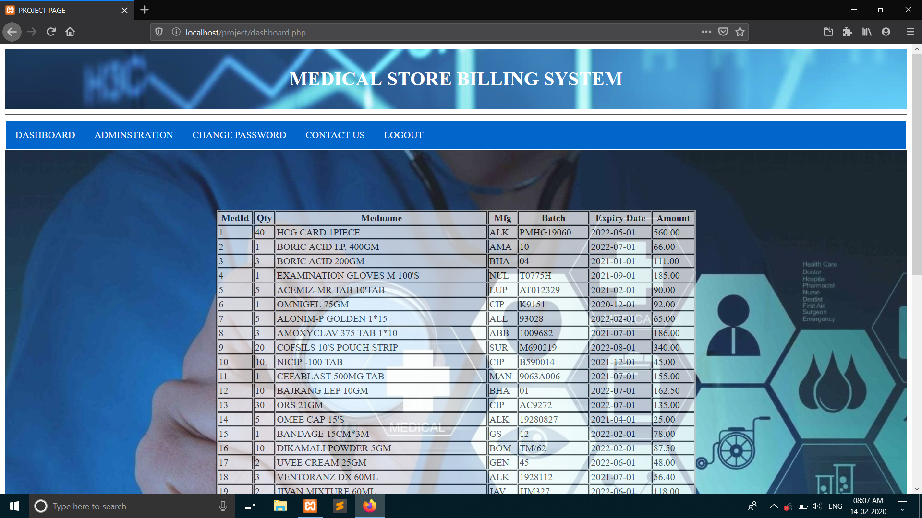
dashboard
This is Dashboard window which include all the data of medicines.
This window shows list of medicines that available in medical store.

Slide 9
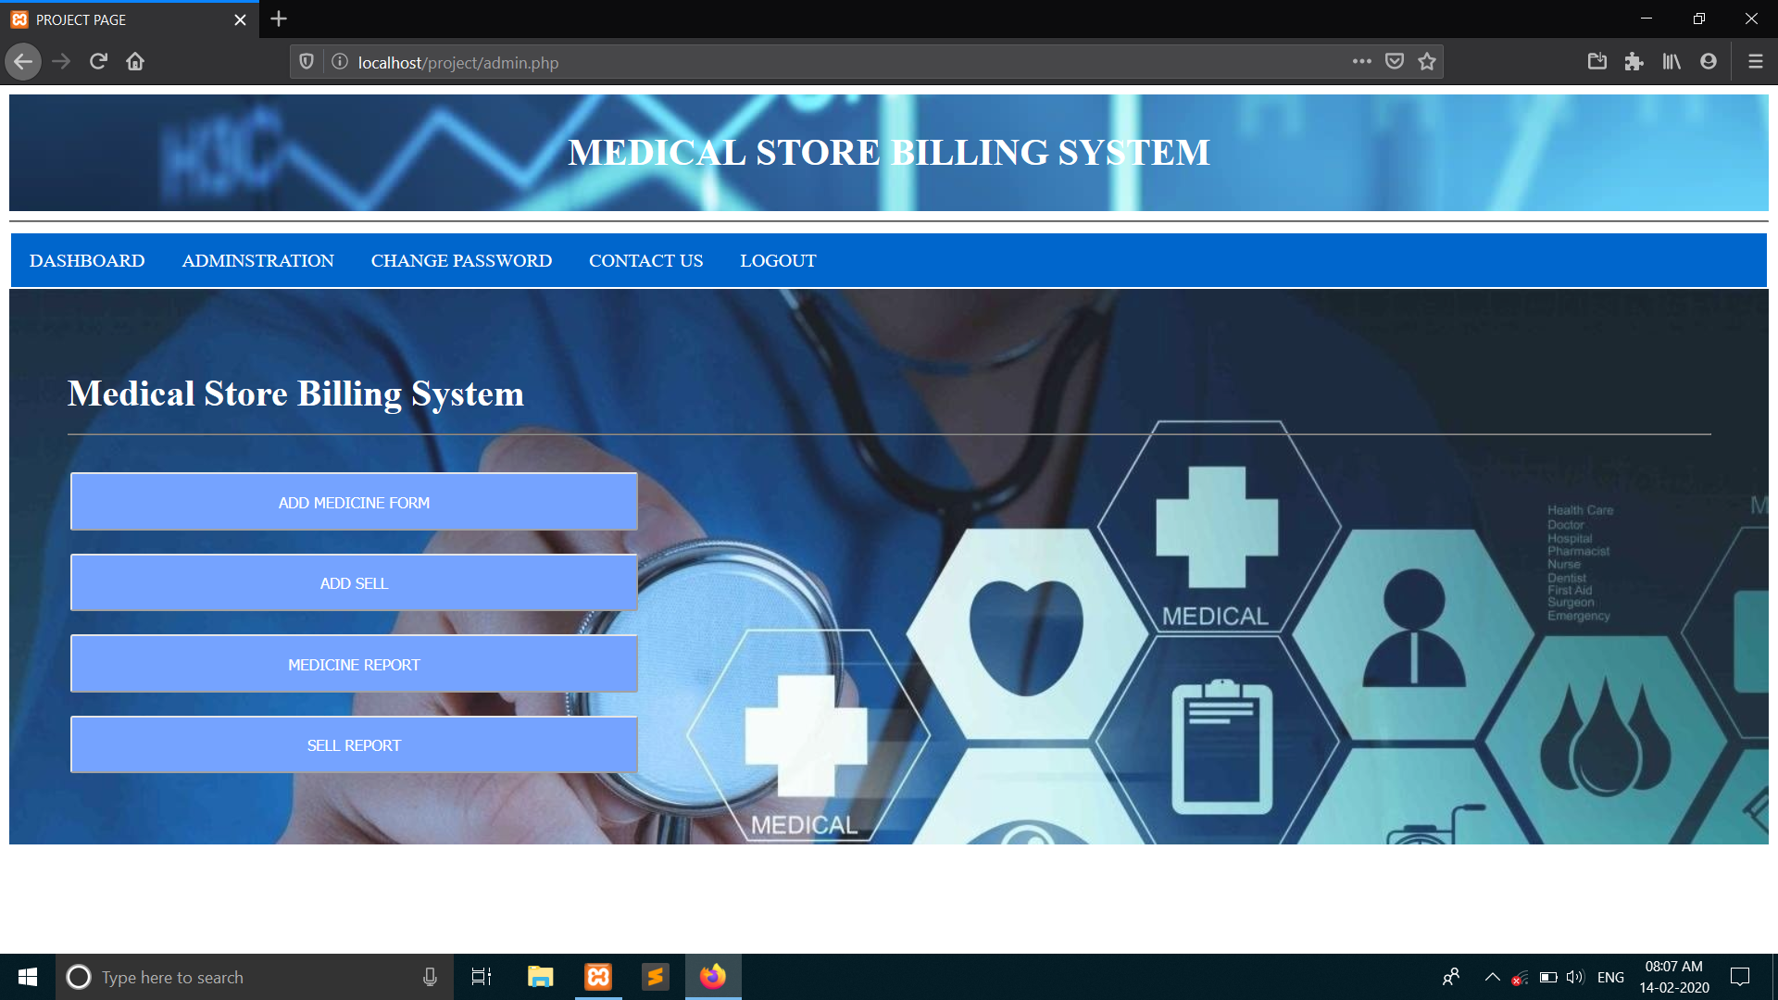
Adminstration
This window is used for adding medicine, sell report etc.
This page contain all record of sell and buy.

Slide 10
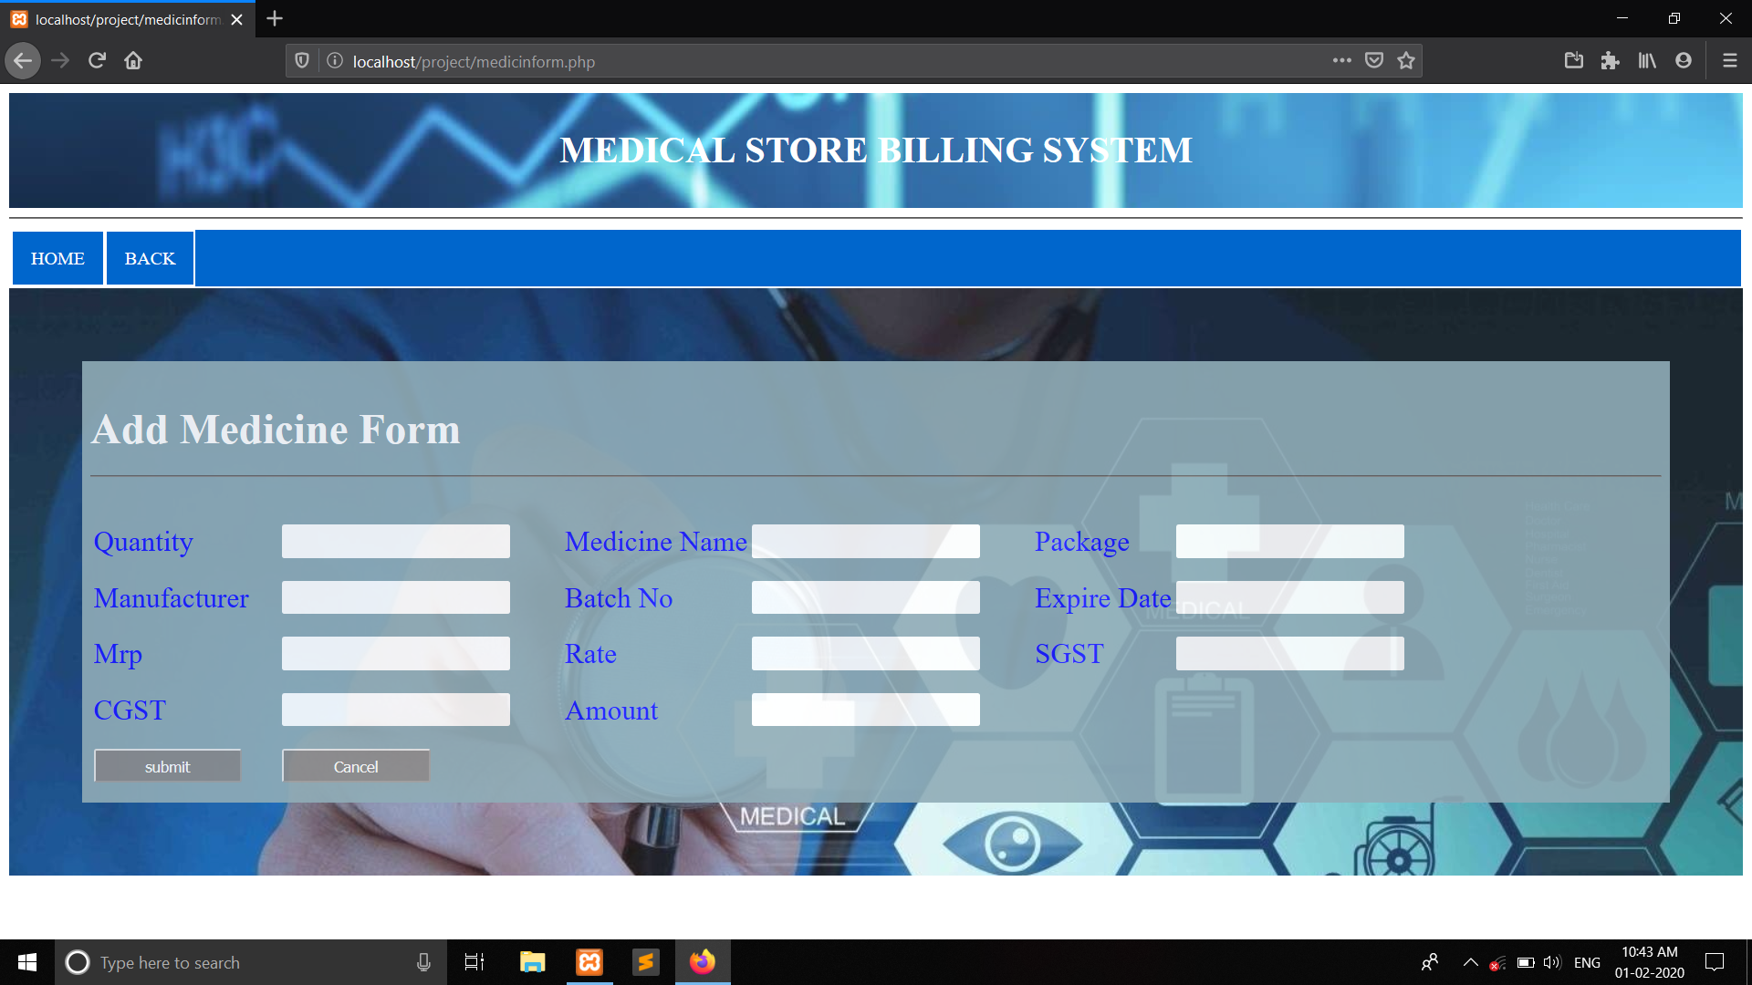
Add medicine form
This page is used for adding new medicine to database.

Slide 11
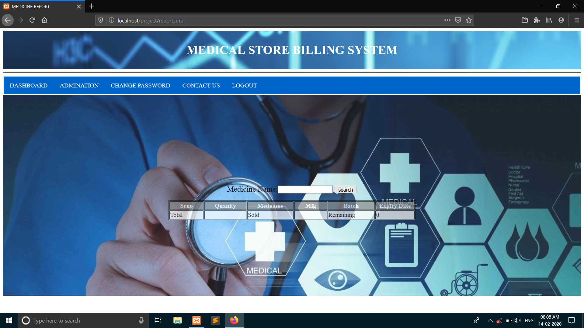
Sell report
This window is use for sell report. It can show all the sell and buy medicine record of the store.

Slide 12
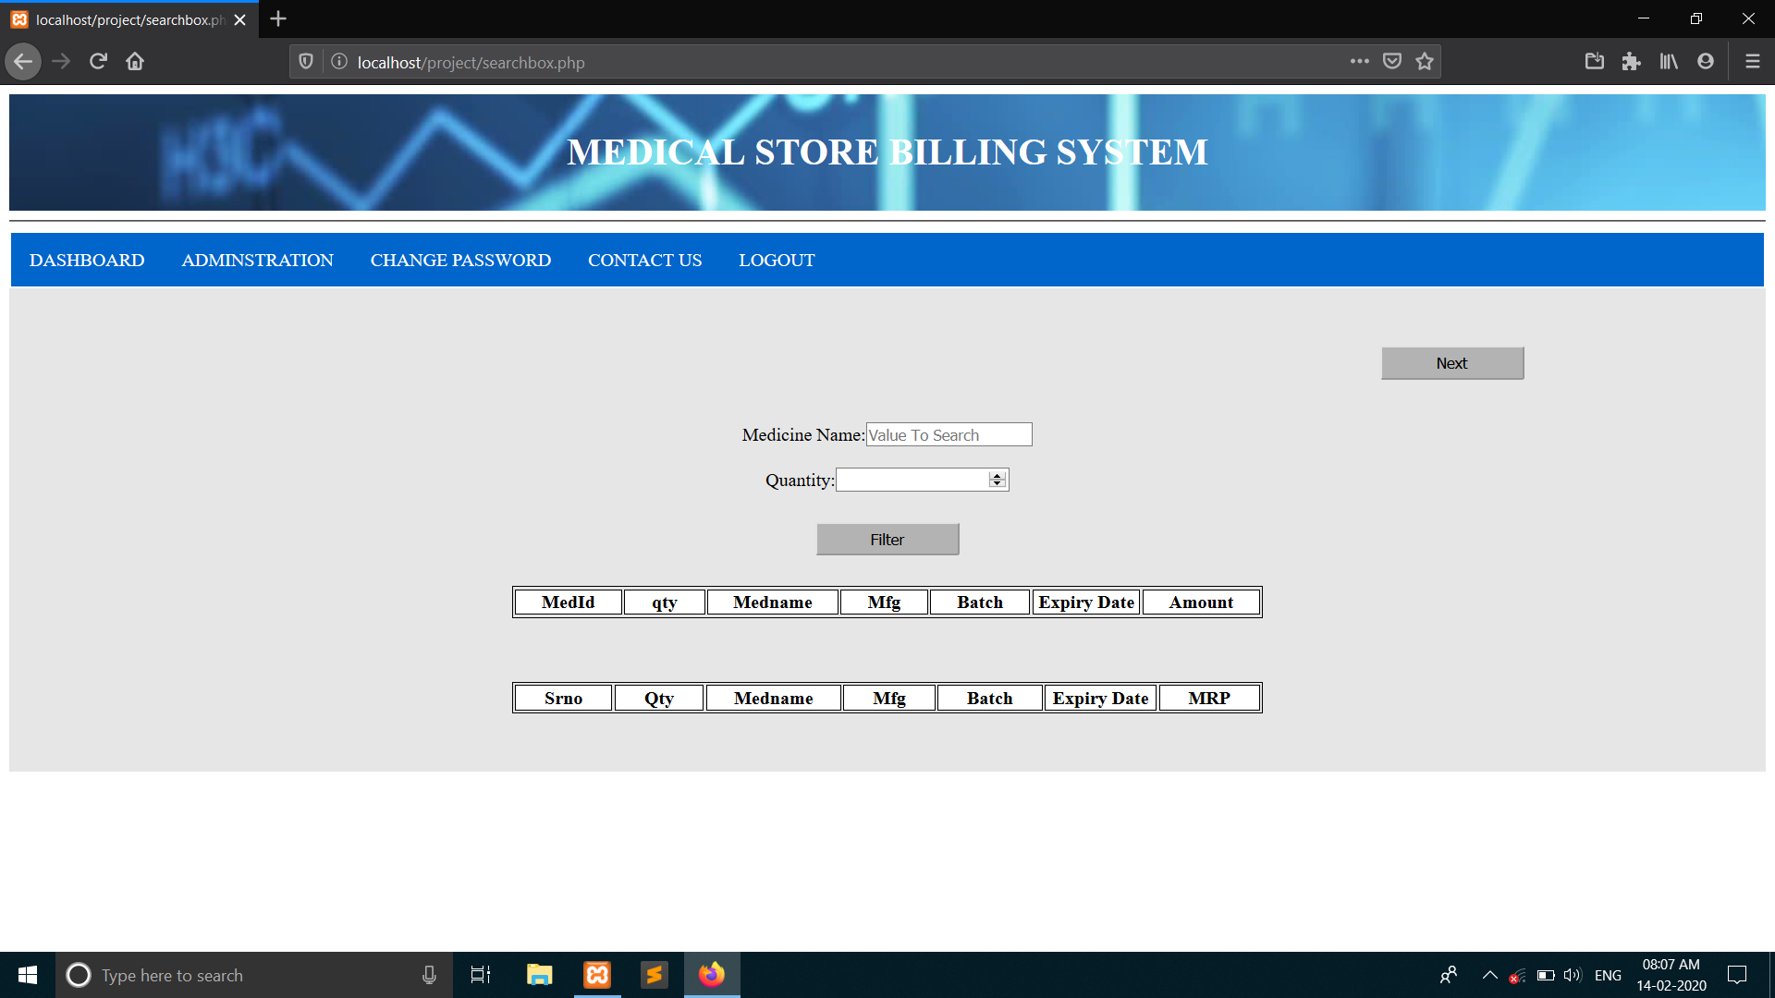
Billing page
This window contain details of medicine which we sell to customers.
We also contain customer details and records.

Slide 13
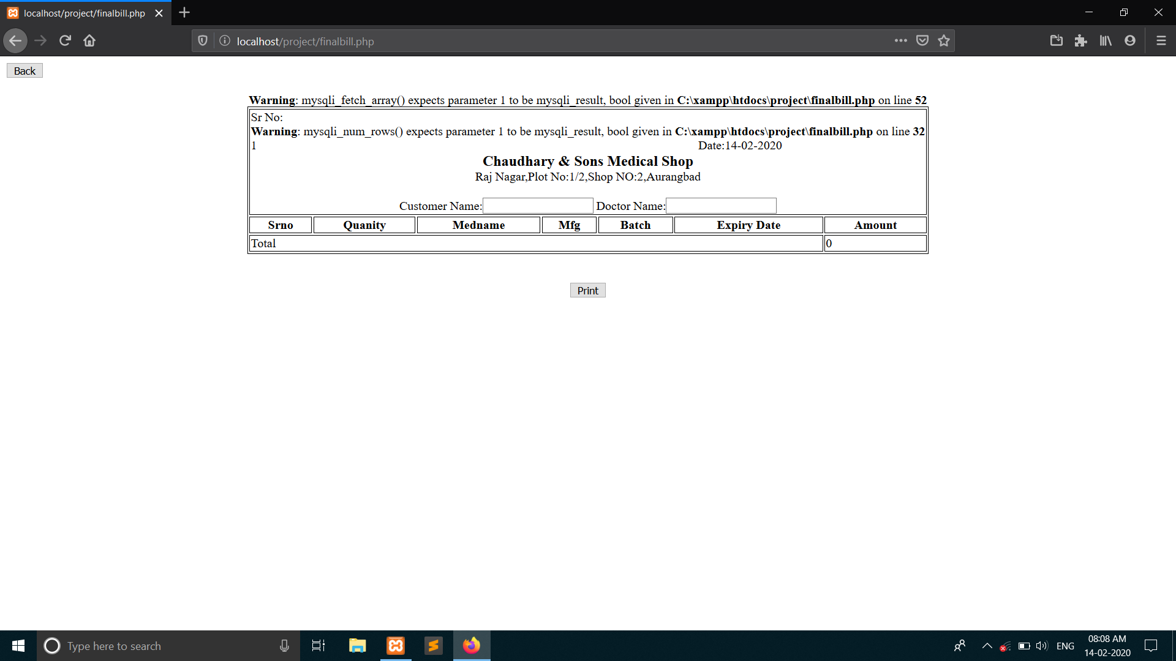
Billing page (print)
This is final billing page. We can print the customer bill.

Slide 14

Medicine report
This window show all the medicine which was sell in year and so on.

Slide 15
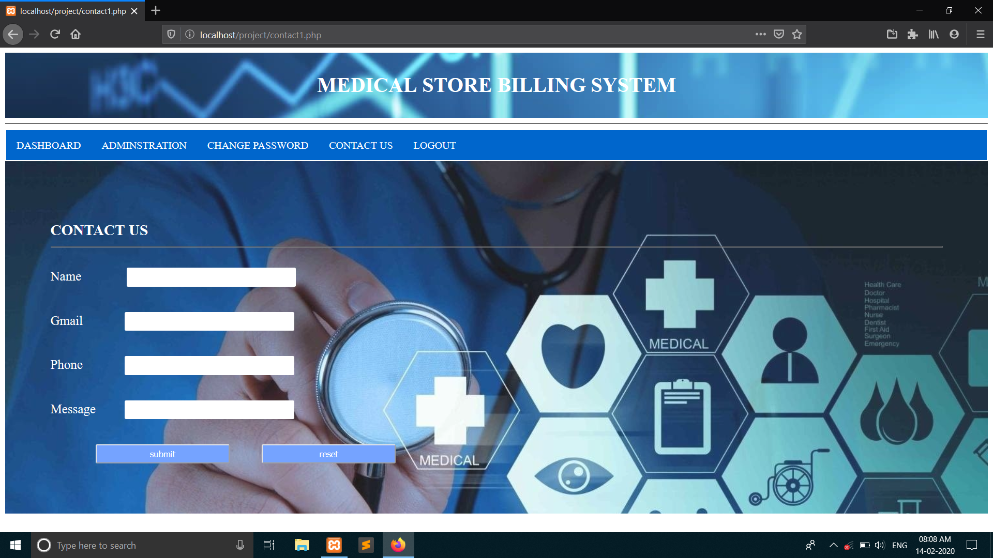
Contact us
If user have any problem with web app they can contact us.

Slide 16
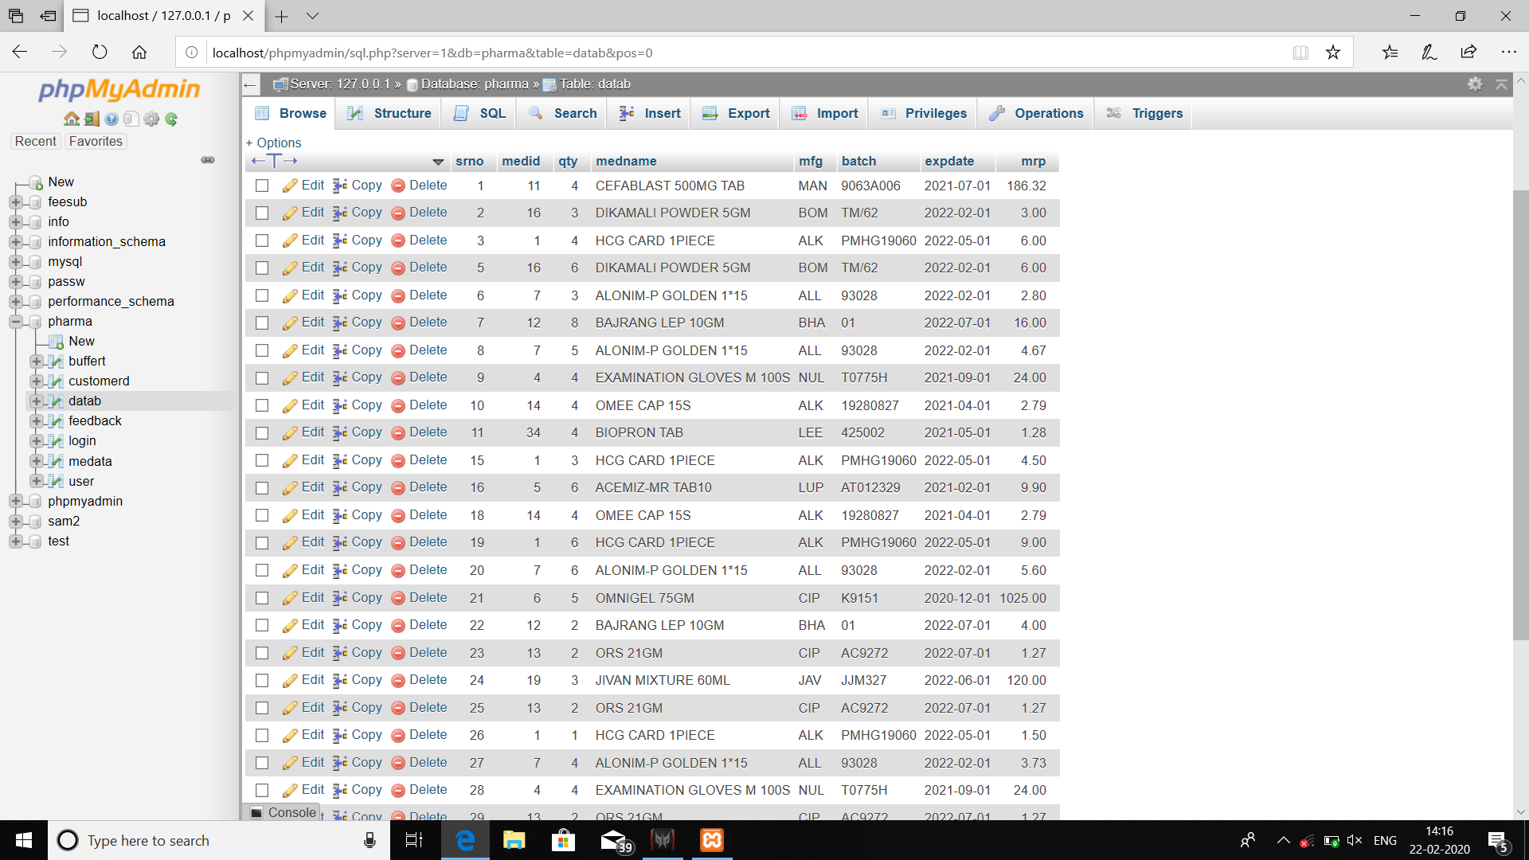
Database page
This is phpMyAdmin database page, which is backbone of our web application.
It contains whole medicines.

Slide 17
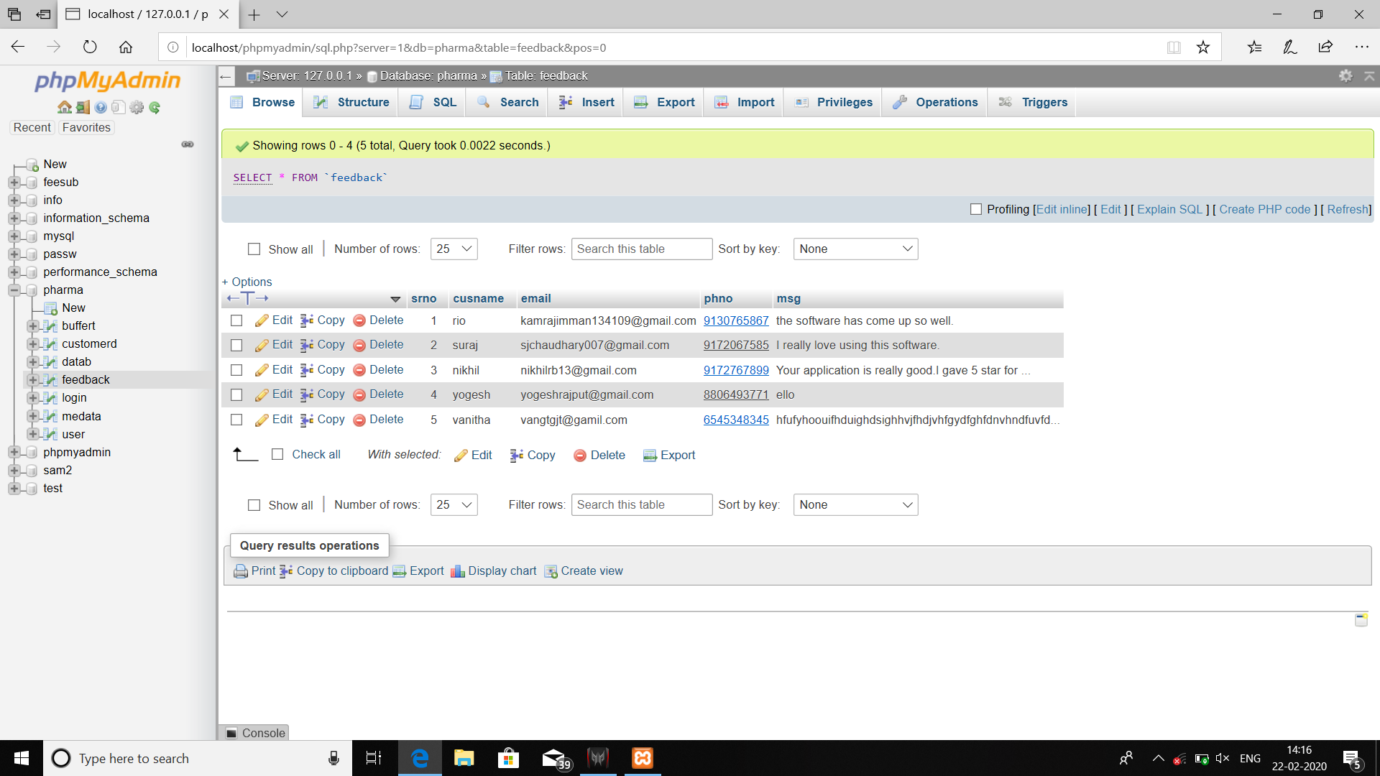
Feedback Database
This database for user.
It contain username and password.

Slide 18
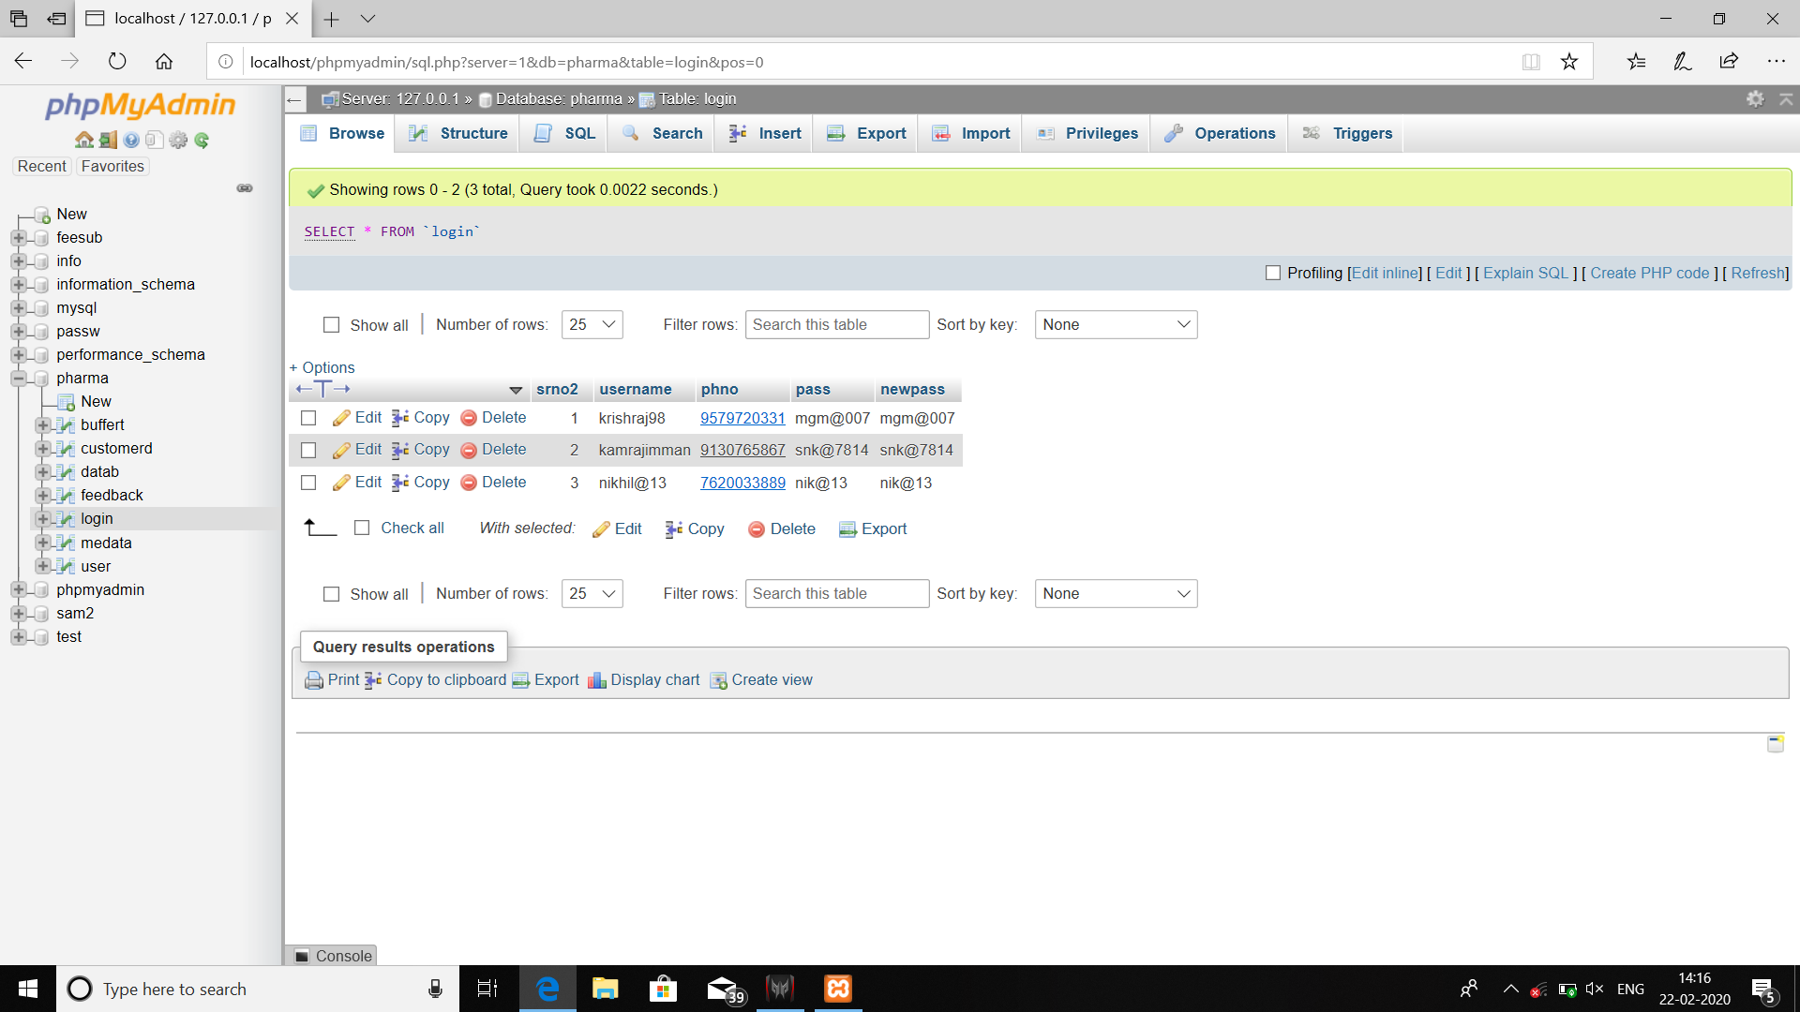
Login Database
This page contain database of admin username and password
Using these admin can login and logout.

Slide 19
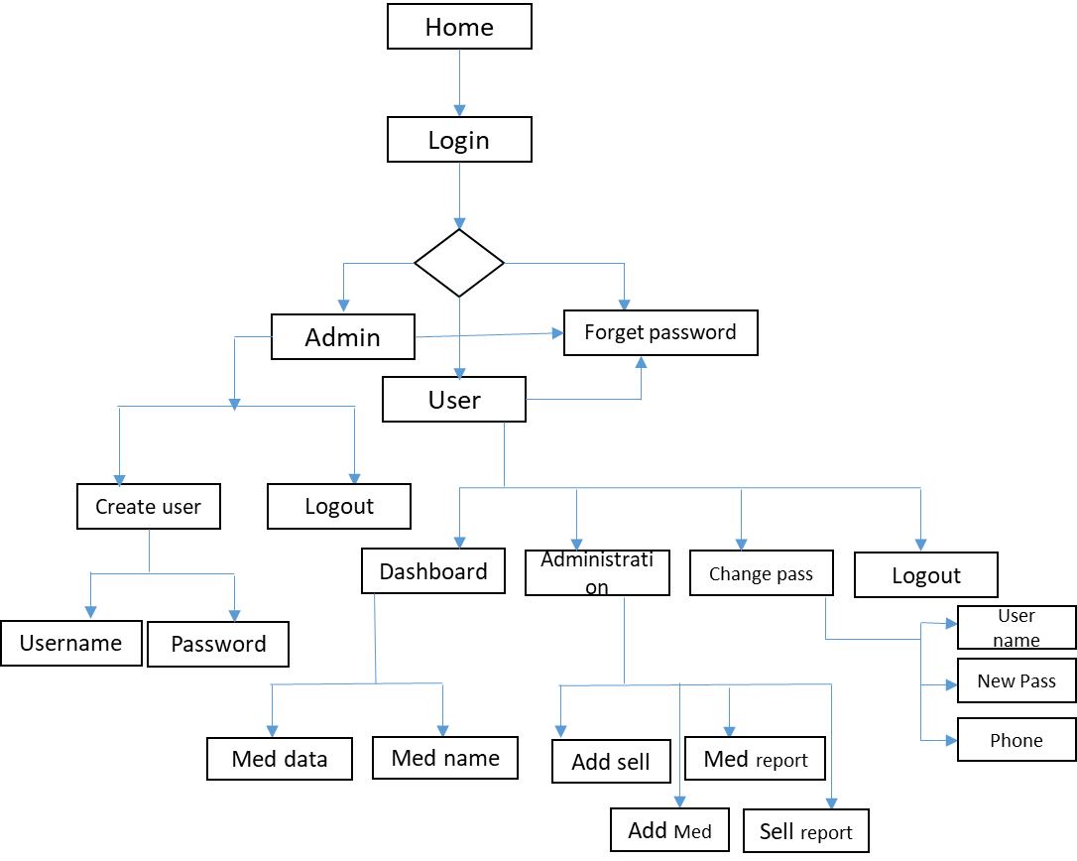
DATA FLOW DIAGRAM

Slide 20
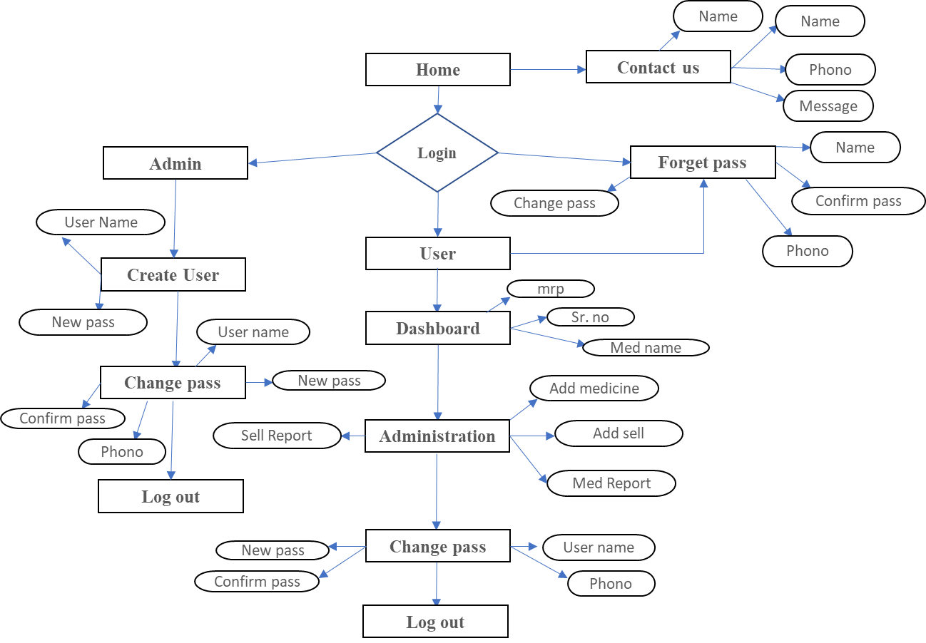
E R-DIAGRAM

Slide 21
CONCLUSION-:
We still have much more to accomplish in this project. Yet at the current stage it is usable to a certain limitations. We are happy with the outcome and same will be the response of the customers who will use our project. The project has been made as simple as possible to be user-friendly. User can always keep an eye on the available stocks.
We plan to provide more facilities in upcoming time and do changes as requested by the customers.

